Slide 1
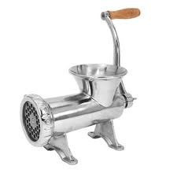
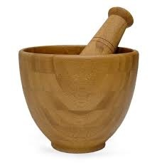
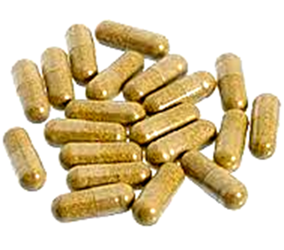
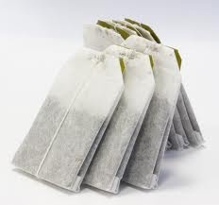
Herbal Medicine Preparation and Ethnopharmacy
Presented by
Prof. Gilbert Ezengige

Slide 2
Herbal Medicine
The World Health Organization defines herbal medicines as “finished, labeled medicinal products that contain as active ingredients aerial (above ground) or underground parts of plants, or other plant material or combination thereof, whether in crude state or as plant preparations” (WHO, 1991)

Slide 3
Factors that Influence Medicinal Plants Quality
Type of soils
Climate
Time of the year of harvest
Effect of stellar radiations in a geographical location
Man made factors such as air, land and aquatic pollution

Slide 4
Harvesting Medicinal Plants
Gather herbs preferably in dry weather.
Herbs, unless otherwise specified should be harvested when they are in full bloom, i.e., when they are either flowering or fruiting.
Do not harvest medicinal plants that grow near gutters/sewage, industrial areas and roadsides to avoid using herbs overloaded with toxic matters.
Unless otherwise specified, tree barks flowers, leaves, seeds and fruits are best harvested in the day time.
Unless otherwise specified, roots are best harvested in the evening/night time.

Slide 5
Harvesting Medicinal Plants
Roots of plants are generally more potent when harvested in the evening time or night.
Wilted, molted, infected and insect-eaten leaves should not be gathered for medicinal preparation.
Avoid unnecessary bruising of plant tissues so as to minimize plant deterioration an oxidation prior to drying process and storage.

Slide 6
Production Techniques
Drying of Herbs
Dried herbs can last for 3 years or longer and still retain their medicinal constituents.

Slide 7
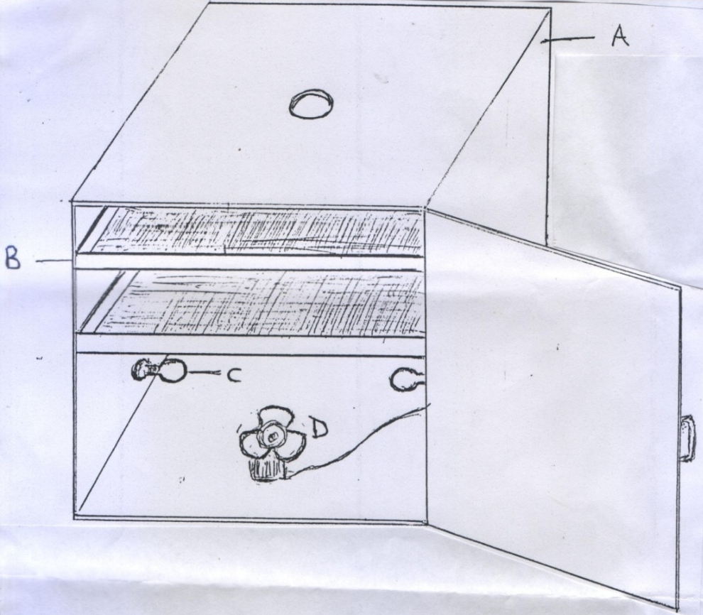
Production Techniques
A Simple Herb Dryer
A. Plywood Cabinet
B. Dryer Tray (Metallic Mesh)
C. 100 Watts Filament Bulb
D. Small Motorized Fan

Slide 8
Production Techniques
Grinding of Herbs
If plants are to be stored for a long period before packaging, it is not advisable to reduce them to fine powder; they can be cut to pieces, dried and stored.

Slide 9
Production Techniques
Storage of Herbs
Powdered herbs should be stored in a dry and shaded room or apartment. They can be packed preferably in large amber bottles or dark brown glass jars; this prevents the harmful effect of light, humidity and parasites on the stored herbs.

Slide 10
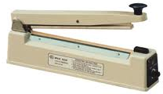
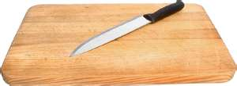
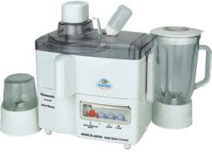
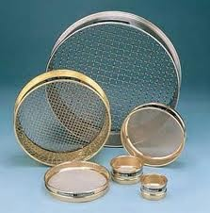
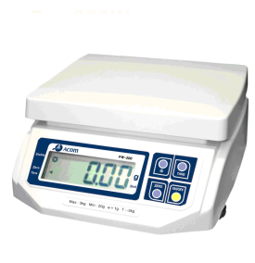
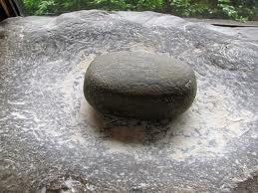
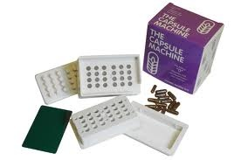
Production Techniques
Basic Herb Processing Tools

Slide 11
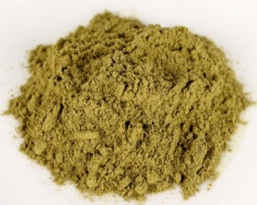
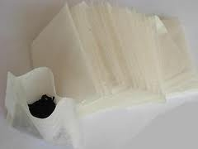
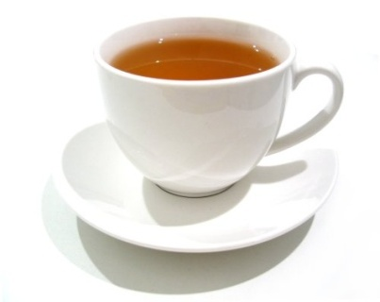
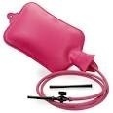
Production Techniques
Herb dispensing modes
Herb powder Herbal infusion Herbal enema

Slide 12
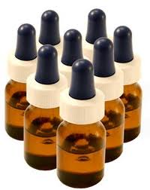
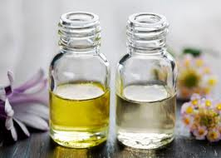
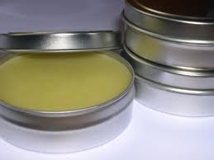
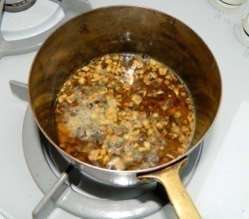
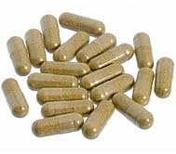
Production Techniques
Herb dispensing modes
Decoction Herbal Capsule Herbal Oil Ointment Tincture

Slide 13
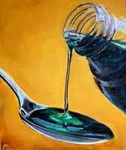
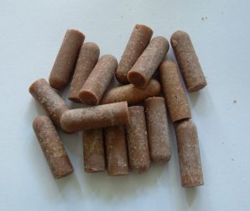
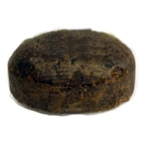
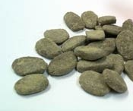
Production Techniques
Herb dispensing modes
Syrup Suppository Herbal Soap Lozenges

Slide 14
Production Techniques
Preservation of Herbal Medicine
Drying for herbal teas, capsules and tablets.
Alcohol to extract as well as preserve herbal preparations.
Apple cider vinegar to preserve liquid medications

Slide 15
Dosages in Herbal Medicine
Factors influencing herb dosage
Potency of the herb and its level of toxicity
Body size, weight and height
The severity of the ailment
Age of the patient

Slide 16
Dosages for Children
Dosages should be adjusted when making herbal medicines for children by using;
Cowling's Rule: The child's age at his or her next birthday divided" by: 24. For a child approaching 8 years, the dose would be 8 divided by 24; or 1/3 the adult dose.

Slide 17
Medicinal Actions of Herbs
This is an approach of categorizing herbs on the basis of their physiological effects on the body and the illnesses they alleviate
When actions of individual herbs are studied and noted, the chances of making wrong combinations of herbal medicines become slim.

Slide 18
Medicinal Actions of Herbs
Analgesics, Anticoagulant, Antiemetics
Antilithics, Antimicrobials, Antipyretics
Aphrodisiacs, Bitters, Cardiotonics
Depuratives, Diuretics, Emmenagogues
Haemostatic/ Styptic, Hypoglycemic
Hypotensives, Vermifuges, Vulnerary

Slide 19
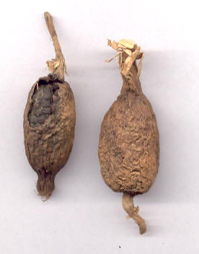
Aframomum melegueta
COMMON NAME: Alligator pepper
PART(S) USED: Seeds
THERAPEUTIC PROPERTIES
Aphrodisiac
Galactagogue
Anthelmintic
Analgesic
Stimulant
Carminative
Antimicrobial
Impotency
Dysmenorrhea
Colds

Slide 20
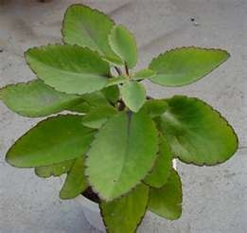
Bryophllum pinatum
COMMON NAME: Resurrection plant
PART(S) USED: Leaves
THERAPEUTIC PROPERTIES
Antihistamine
Anti allergic
Cough and upper respiratory infections
Juice for earache (ear drop)
Immunomodulator
Antispasmodic
Antibacterial, Antiviral and Antifungal
Lowers blood cholesterol
Mildly sedative

Slide 21
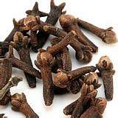
Eugenia aromaticum
COMMON NAME: Clove
PART(S) USED: Flower buds
THERAPEUTIC PROPERTIES
Toothache (topical application of the oil)
Aids digestion, relieves bloating/intestinal gas
Relieves bronchial catarrh
Controls bad breath
Bactericide, Nematicide, Fungicide
Allays nausea and vomiting
Checks diarrhea
Allays dizziness due to poor blood circulation
Relieves headache, abdominal and muscle aches
Remedy for athlete’s foot

Slide 22
Thanks for
Listening
Dr Gilbert Ezengige
Iridologist &
Natural Medicine Practitioner

